Slide 1
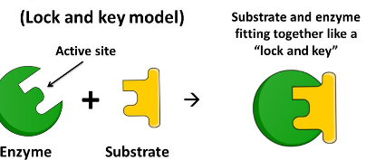
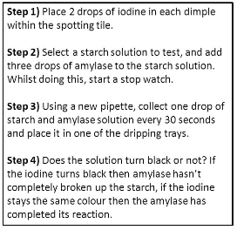
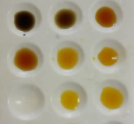
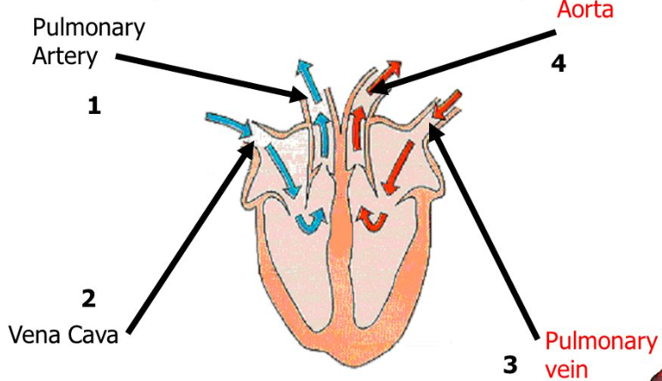
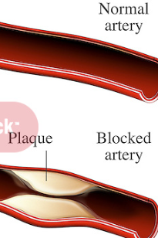
B2 Knowledge Organiser – 4.2.2 – Organisation
1
2
3
Enzymes | Enzyme action |  | Food tests – RP
Required practical – Effect of pH on amylase |  | Health issues – risk factors | Coronary Heart Disease
The heart
Amylase – Breaks down carbohydrate to starch
Lipase – Breaks down lipids to glycerol and fatty acids
Proteases – Break down protein to amino acids
Bile – Made in the liver. Emulsifies fats to provide larger surface area for enzyme action
Active site – Where substrate binds.
Complimentary shape
When denatured bonds holding active site break – changes shape
Substrate can longer bind
Test for sugars – Benedict’s solution – Blue → orange/red
Test for protein – Biuret – Blue → purple
Test for starch – Iodine – Yellow → blue/black
4
5
6
Diet
Smoking
Lack of exercise
Obesity
Alcohol
Carcinogens – cause cancer
Cancer – changes in cells that cause uncontrollable growth and division
Build of fatty material in artery leads to narrowing
Reduces blood flow to heart
Lack of oxygen for heart muscles to respire
Treatment –
Statins – lower cholesterol
Stents – keep artery open
7
8
Blood vessel | Artery | Vein | Capillary
Direction of blood flow | Away from heart | To the heart
Lumen size | Small lumen | Large lumen | Very small
Muscle thickness | Thick layer of muscle – high pressure | Thin layer of muscle – low pressure | No muscle layer
Outer wall | Thick outer wall | Thin outer wall | Single layer of cells

Slide 2
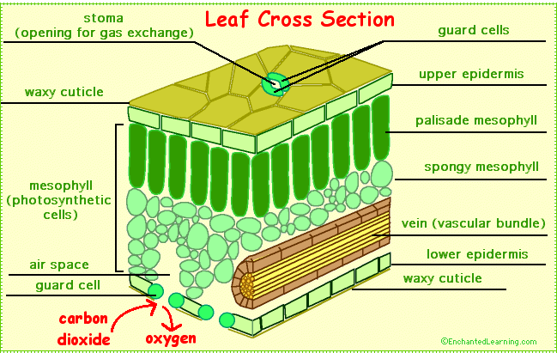
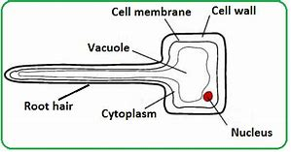
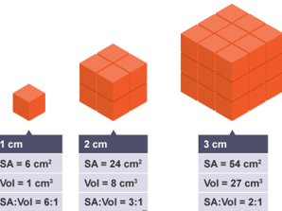
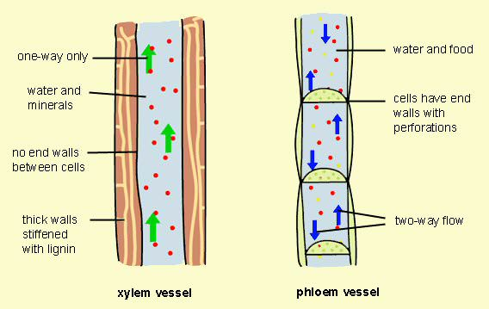
B2 Knowledge Organiser – 4.2.3 – Plant tissues and systems
1
2
Plant tissues |  |  | Root hair cells
 |  |  | SA:Vol ratio
Transpiration | Translocation Glucose produced from photosynthesis is converted to sucrose Transported in phloem vessels Transported to leafs and roots for growth Sucrose moves through elongated cells through holes in the end walls | Structure of xylem, phloem and stomata
Epidermal tissue – Waxy cuticle – prevents water loss
Palisade mesophyll – Adapted to absorb light – lots of chloroplasts containing chlorophyll, cells packed tightly together
Spongy mesophyll – Cells packed loosely for efficient gas exchange, cells covered in thin layer of water for gases to dissolve in and they move into and out of cells
Large surface area - absorb more water via osmosis
Thin cell wall – short diffusion pathway
No chloroplasts
Mineral uptake via active transport
3
Larger organisms have a smaller SA:Vol ratio
Requires a transportation system
Xylem – transports water and minerals up the plant stem – strengthened by lignin
Phloem – transports sugars (sucrose) produced by photosynthesis around the plant for growth
Meristem tissue – Found at root and shoot tips for growth
4
5
6
Water diffuses out of the leaf via the stomata
Water is drawn from the xylem to replace this water, this is the Transpiration stream
Xylem are hollow tubes strengthened by lignin
Rate decreased by humidity
Rate increased by temperature, air movement and light intensity

