Slide 1
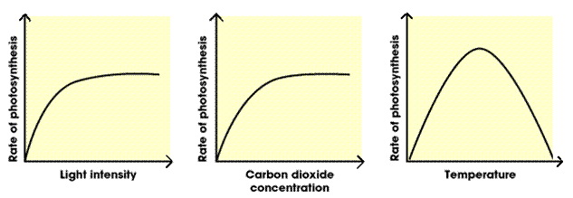
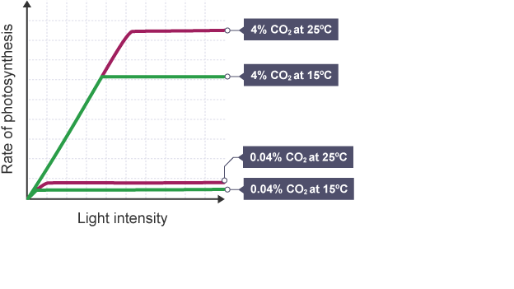
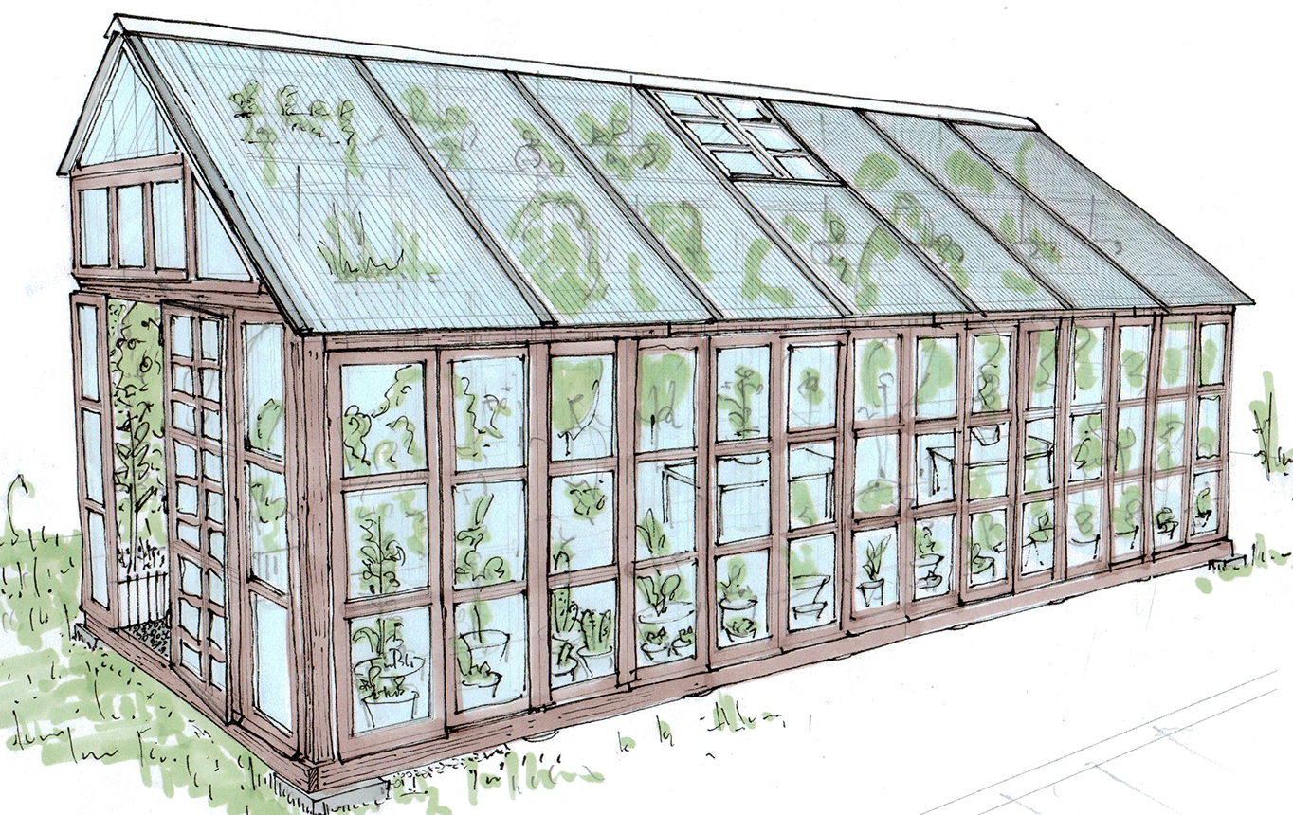
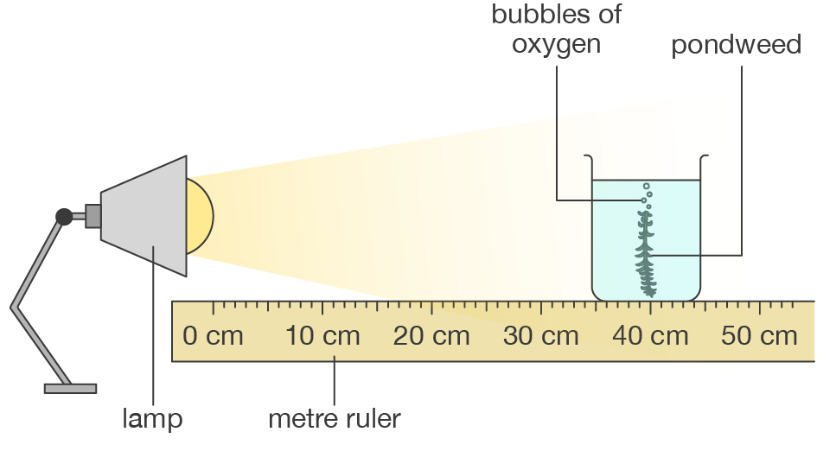
B4 Knowledge Organiser – 4.4.1 –Photosynthesis
1
2
Photosynthesis reaction Photosynthesis is an endothermic reaction. Energy is transferred from the environment to the chloroplasts by light. |  | Rate of photosynthesis Chlorophyll also affects the rate. More chlorophyll = faster rate.
Factors affecting rate | Inverse square law for light The intensity of the light from a source is inversely proportional to the square of distance from the source. | Greenhouses Light, temperature and CO₂ can all be controlled to get the maximum photosynthesis rate. But yields need to be balanced against increased costs. | Plants using glucose from photosynthesis used for respiration converted into insoluble starch for storage used to produce fat or oil for storage used to produce cellulose Combined with nitrates to produce amino acids
Required practical – light intensity and rate of photosynthesis
3
4
5
6
7
Measure 20cm³ of sodium hydrogen carbonate solution and pour into a boiling tube.
Collect a 10cm piece of pond weed and attach a paper clip to one end.
Clamp the boiling tube, ensuring you will be able to shine the light onto the pond weed.
Place a meter ruler next to the pond weed.
Place the lamp 10cm away from the pondweed.
Wait 2 minutes until the pond weed has started to produce bubbles.
Using a stopwatch count the number of bubbles produced in a minute.
Repeat stages 5-7, moving the lamp 10cm further away from the pond weed each time until you have 5 different distances.
Repeat twice more so you have 3 readings for each distance.
Independent variable = light intensity
Dependent variable = amount of bubbles produced. To be more accurate instead of counting bubbles collect gas in a pas syringe.
Control variables = time and length of pond weed. Bench lamp used to control light intensity and a thermometer in the in the pond weed water controls the temperature.

Slide 2
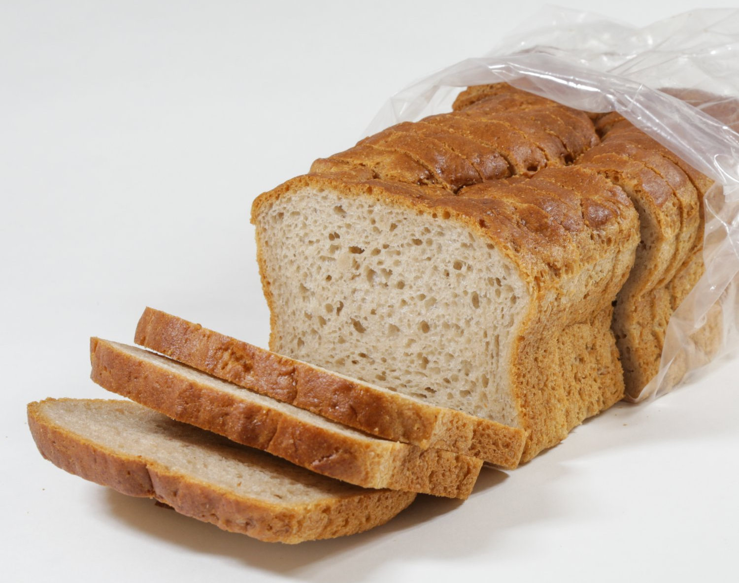
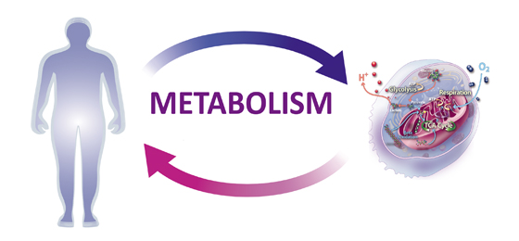
B4 Knowledge Organiser – 4.4.2 – Respiration
1
2
Respiration Occurs continuously in all living cells. It is an exothermic reaction. The energy transferred supplies all the energy needed for living processes. Organisms need energy for: chemical reactions to build larger molecules movement keeping warm. Aerobic respiration Aerobic respiration produced a lot more energy than anaerobic respiration. | Anaerobic respiration As the oxidation of glucose is incomplete in anaerobic respiration much less energy is transferred than in aerobic respiration. Anaerobic respiration in plant and yeast cells (fermentation) is used to manufacture bread and alcoholic drinks. | Metabolism
Response to exercise
4
Metabolism is the sum of all the reactions in a cell or the body.
The energy transferred by respiration in cells is used by the organism for the continual enzyme controlled processes of metabolism that synthesise new molecules.
Metabolism includes:
conversion of glucose to starch, glycogen and cellulose
the formation of lipid molecules from a molecule of glycerol and three molecules of fatty acids
the use of glucose and nitrate ions to form amino acids which in turn are used to synthesise proteins
respiration
breakdown of excess proteins to form urea for excretion.
3
During exercise the body needs more energy so the respiration rates increase.
The heart rate, breathing rate and breath volume increase during exercise to supply the muscles with more oxygenated blood.
If insufficient oxygen then anaerobic respiration takes place in muscles, this causes lactic acid to build up. During long periods of vigorous activity muscles become fatigued and stop contracting efficiently.
Blood flowing through the muscles transports the lactic acid to the liver where it is converted back into glucose. Oxygen debt is the amount of extra oxygen the body needs after exercise to react with the accumulated lactic acid and remove it from the cells.

