Slide 1
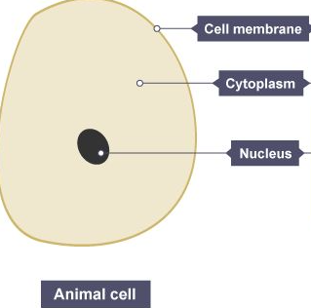
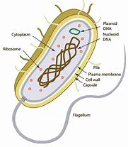
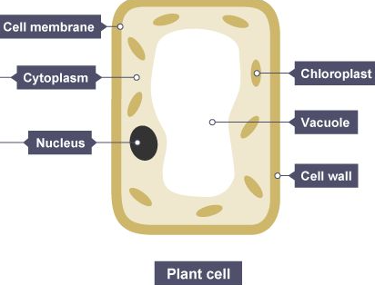
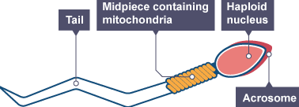
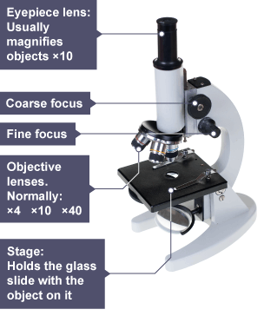
B1 Knowledge Organiser – 4.1.1/4.1.2 - Cell Biology
2
3
Nucleus: contains genetic information. Controls the activities of the cell.
Cell membrane: Controls what goes in/out of the cell.
Cytoplasm: where chemical reactions happen.
Chloroplasts: absorbs light energy so the plant can make food.
Permanent Vacuole: contains liquid to keep the cell rigid.
Cell wall: strengthens the cell.
Mitochondria – Releases energy from respiration
Ribosome – Makes protein
Prokaryotic cells Bacterial cells Have cytoplasm, cell membrane and cell wall Do not have a nucleus DNA found as a loop - plasmid | Eukaryotic cells |  | Cell specialisation Specialised cells have a particular function Identify the adaptation and explain how it allows the cell to perform its function Sperm cell: Tail – swim to egg, Lots of mitochondria – requires lots of energy
Cell division – Mitosis – (Growth and repair) |  | Microscopy – Required Practical
Stem cells |  | Separating mixtures.
1
4
5
Chromosomes are made of DNA and carry a large number of genes. Found in pairs. 23 pairs in each human cell. The cell cycle:
Cell grows to increase the number of sub-cellular structures, e.g. mitochondria and ribosomes
DNA replicates
Chromosomes line up on the equator
Spindle fibres pull chromosomes apart so one copy is at each end of the cell
Nucleus divides
Cytoplasm and cell membrane divides to form two identical cells
Maths skills:
1,000 µm = 1mm
µm → mm divide by 1000
Increasing magnification makes an image bigger
Does not “zoom in”
Remember:
A = Actual size
I = Image size
M = Magnification
6
Stem cell applications
7
Stem cells are undifferentiated cells which are capable of differentiating into many types of cell
Stem cells from human embryos can be cloned and made to differentiate into different types of human cell
Stem cells from adult bone marrow can form blood cells
Treatment from stem cells may help paralysis and diabetes
Meristem tissue in plants can differentiate into any type of plant cell
An embryo is produced with the same genes as the patient
Stem cells from the embryo are not rejected by the patient’s body so may be used for medical treatment
Risk of viral infection
Stem cells from meristems in plants can be used to produce clones of plants quickly and economically
Rare plants can be cloned to protect from extinction
Crop plants with resistance to disease can be produced in large numbers

Slide 2
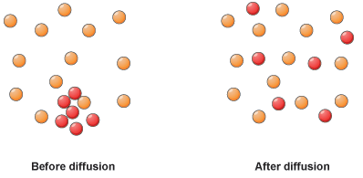
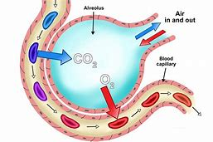
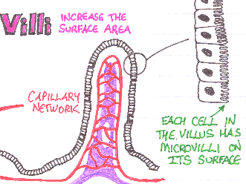
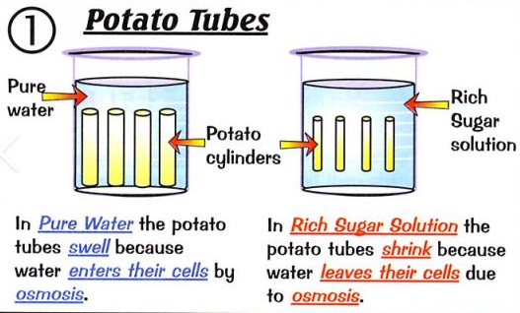
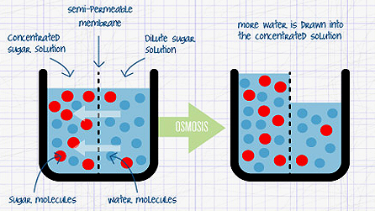
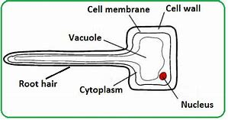
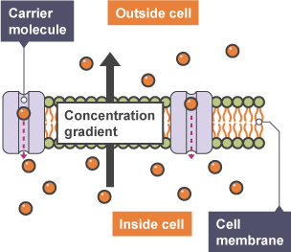
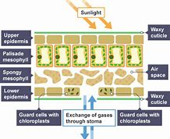
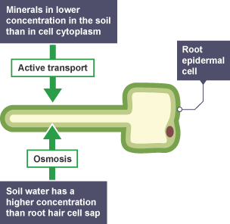
B1 Knowledge Organiser – 4.1.3 – Transport in cells
1
2
3
Diffusion |  | Diffusion - Contexts Gas exchange Digestion Respiration | Diffusion - Adaptations E.g. alveoli/microvilli Large surface area Short diffusion pathway Good blood supply
Osmosis Movement of water molecules from a more dilute to concentrated solution | Osmosis - Adaptations Root hair cell: large surface area, absorbs more water | Osmosis – Required practical
Active transport
Transport of substances down a concentration gradient
Gases
Liquids – except water
High to Low concentration
Passive process – No energy required
4
5
6
Independent variable – Concentration of sugar solution
Dependent variable – Change in mass of potato
Control variables – Volume of sugar solution, time in sugar solution
7
Contexts
8
Transport of substances against a concentration gradient
Low to High concentration
Requires energy released from respiration
Movement of particles

